Slide 1



Sentiment Analysis using Azure Data Factory and Azure Cognitive service
19th NOV 2022 11:30

Slide 2
Abstract
In this session, I will provide a basic introduction of Azure Synapse. I will show a case study to move data from Azure Blob Storage to Azure SQL Server. Furthermore I will show you how you can transform data on-the-fly with Azure Synapse . Also, I will show to how to apply sentiment Analysis on your data using Azure Text Analytics service. This session is about to No code or Low code Data Integration with Azure Synapse This demo will also use the following technologies: * Azure Key Vault *Azure Blob Storage *Azure Sql Server *Azure Cognitive service (for sentiment analysis) * Azure Synapse The main goal of this session is to provide basic knowledge of Azure Synapse using case study so attendee will leave with Synapse knowledge and Also Azure cognitive service and how to apply this in different scenarios.

Slide 3





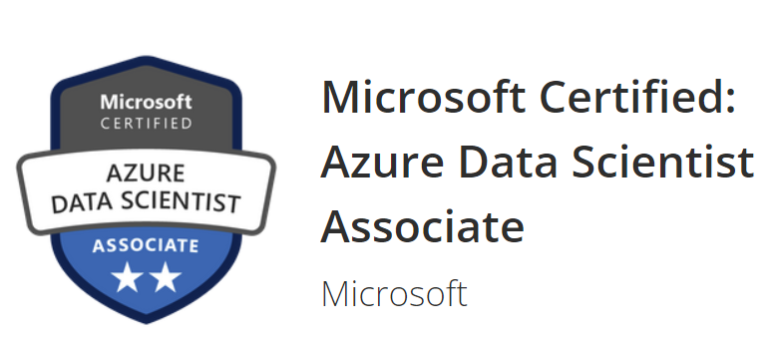
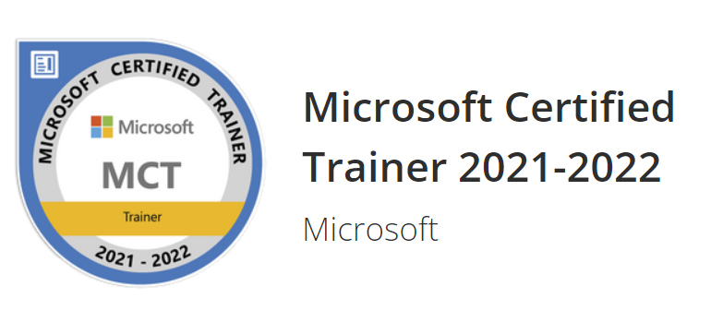

About Me
Alpa Buddhabhatti
Azure Consultant, Cluster Reply
alpaBuddhabhatti/CloudBrew2022
alpabuddhabhatti
@AlpaB7
https://medium.com/@meetalpa

Slide 4
Today’s Agenda
1. Azure Data Factory overview
2. Azure Cognitive service for Language Overview
3. Demo
Sentiment Analysis using Azure Data Factory & Cognitive Services

Slide 5
1. Azure Data Factory overview

Slide 6
What is Azure Data Factory(ADF)?
A cloud-based data integration service that orchestrates and automates the movement and transformation of data.
Azure Platform as a Service (PaaS)
It is Serverless
Only pay for what you have use
Low-code and no-code Solutions

Slide 7
What are Key Components of ADF?
1
Linked services
2
Datasets
3
Activities
4
Pipelines
5
Triggers

Slide 8

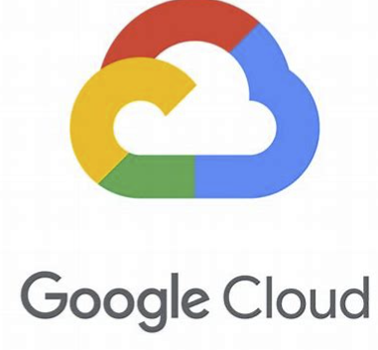



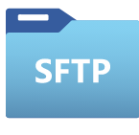






What can you do in ADF?
Data Movement
COPY DATA
~100
Copy activity - Azure Data Factory & Azure Synapse | Microsoft Docs

Slide 9

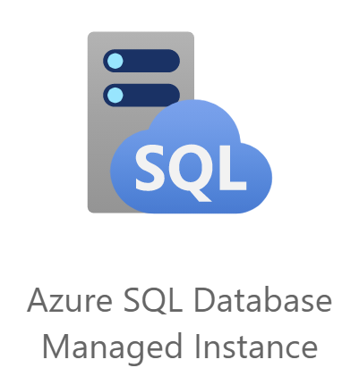

What can you do in ADF?
Data Transformation
TRANSFORMATION
~18
Source transformation in mapping data flow - Azure Data Factory & Azure Synapse | Microsoft Docs

Slide 10

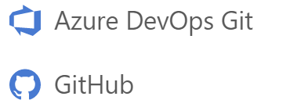


What can you do in ADF?
Pipelines are JSON, ready for Source Control
Built in Git Integration
Monitor
Manage

Slide 11



What can you do in ADF?
A Specific Time
File created or deleted from Blob Storage
Customer Activity such as
Trigger pipeline

Slide 12
What can you do in ADF?
Data Movements
Data Transformation
Easy to integrate
Orchestration
Automation

Slide 13
2. Azure Cognitive service for Language
Azure Cognitive Services Text Analytics

Slide 14
Sentiment Analysis
Azure Cognitive Service for Language
Text Analytics (Text, Documents)
Extract, Classify and Understand text within documents
Sentiment labels (such as "negative", "neutral" and "positive")
NLP - Natural Language processing technique
No code or Low code
Create an Azure Language resource
The REST API or the client library for C#, Java, JavaScript, and Python

Slide 15
3. DEMO Sentiment Analysis using ADF using Cognitive Services

Slide 16
Problem Statement
ADF, Azure SQL Server and Azure Blob Storage
Sentiment Analysis
Without Data Science Expert
No Code Low Code

Slide 17




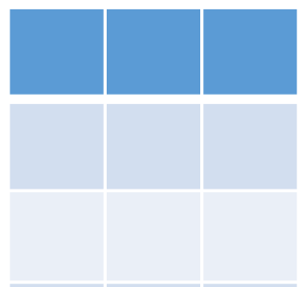



High-level Design
Azure Cognitive Services (Text Analytics)
Azure Blob Storage
(feedback-in)
2
Azure SQL Server
1
3
Azure Data Integration Platform - ADF
Customer Feedback.csv
Azure Key vault

Slide 18
How Azure Cognitive Service integrate with ADF?
1. Endpoint(URL)
2. Key
3. Message Body
4. Headers
1
2
Probability score
Azure Data Factory Pipelines
Azure Cognitive Services

Slide 19
DEMO

Slide 20


Azure Resources
Azure Resources

Slide 21



Key Takeaway
Azure Data Factory
Azure Cognitive Services
Data Movements
Data Transformation
Orchestration
Automation
Serverless and Azure PaaS
Easy to integrate
It summarized big documents and provide sentiments
A wide range of languages
Understand common topics and trends
A Gain deeper understanding about your customer sentiments
DEMO
Read Feedbacks from Blob storage
Apply sentiment analysis on each feedback
Apply transformation and store data to Azure SQL Table

Slide 22
Thank you !!!
Alpa Buddhabhatti
Azure Consultant, Cluster Reply
alpaBuddhabhatti/CloudBrew2022
alpabuddhabhatti
@AlpaB7
https://medium.com/@meetalpa

Slide 23
Q & A
Alpa Buddhabhatti
Azure Consultant, Cluster Reply
alpaBuddhabhatti/CloudBrew2022
alpabuddhabhatti
@AlpaB7
https://medium.com/@meetalpa

